Slide 1
THE PERFORMANCE OF 3 PHASE INDUCTION SQUIRREL CAGE MOTOR
(REPORT)

Slide 2
INTRODUCTION TO MOTOR
A three phase squirrel cage motor is the type of three phase induction motor which functions based in the principle of electromagnetism.
It is called “Squirrel Cage” motor because the rotor inside of it looks like squirrel cage.
The rotor of this motor is a cylinder of steel laminations, with highly conductive metal embedded into its surface.

Slide 3
INTRODUCTION TO MOTOR
This introduces a current in the rotor winding, which produces its own magnetic field. The interaction of magnetic field produce by the stator and rotor windings produces a torque on the squirrel cage rotor.

Slide 4
INTRODUCTION TO MOTOR
Squirrel cage induction motors are used a lot in industry as they are reliable, self-starting and easy to adjust.
Advantage of squirrel cage motor is how easily you can change its speed-torque characteristics. This can be done by simply adjusting the shape of the bars in rotor.

Slide 5
STARTUP PROCESS
When the supply is connected to the stator of a three-phase induction motor, a rotating magnetic field is produced and the rotor of the motor begins rotating and the induction motor starts.
At the time of starting, the motor slip is unity, and the starting current is very large.

Slide 6
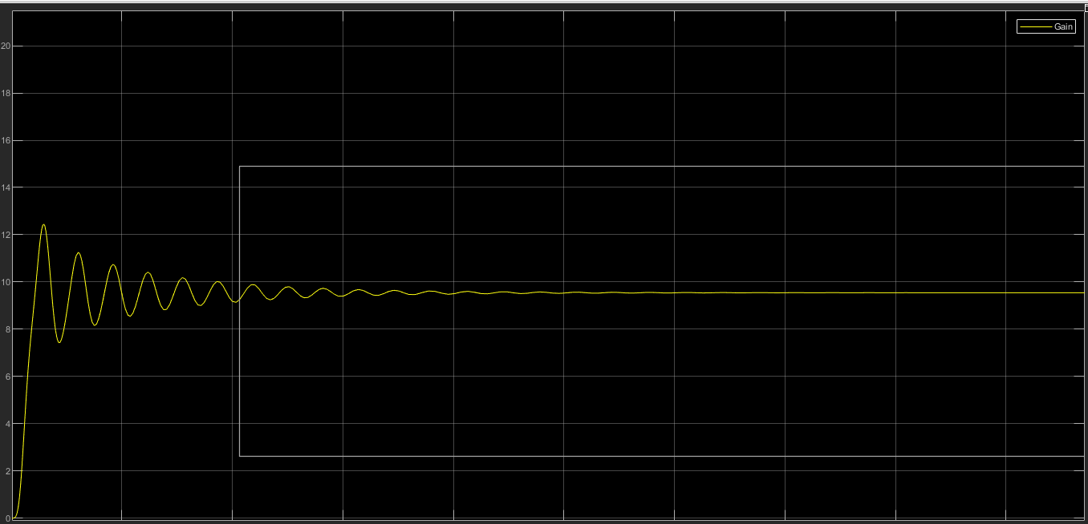
STARTUP PROCESS (CURVE)

Slide 7
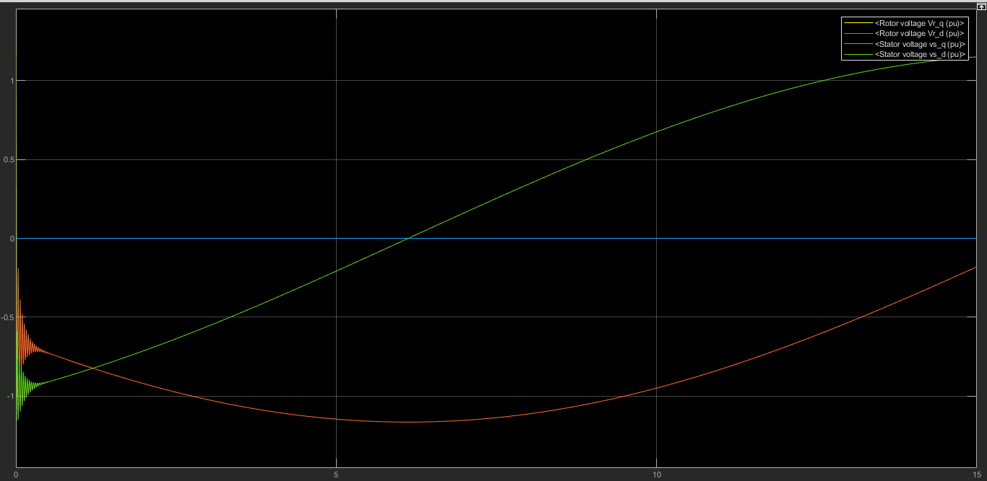
TERMINAL VOLTAGES (CURVES)

Slide 8
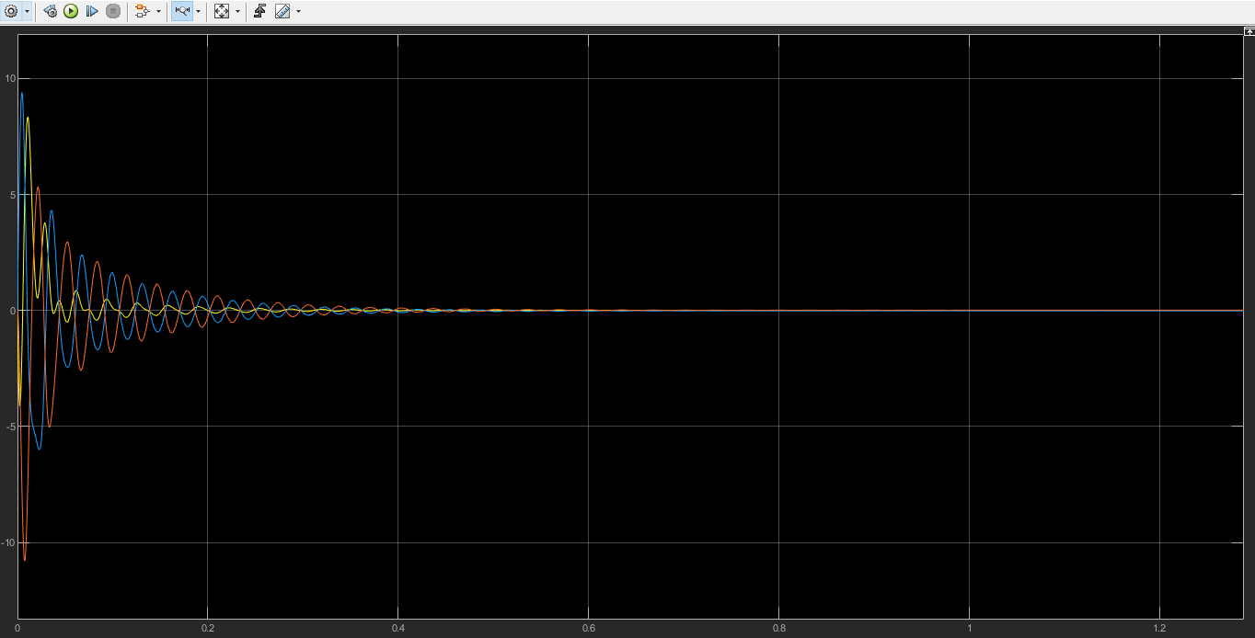
STATOR CURRENTS

Slide 9
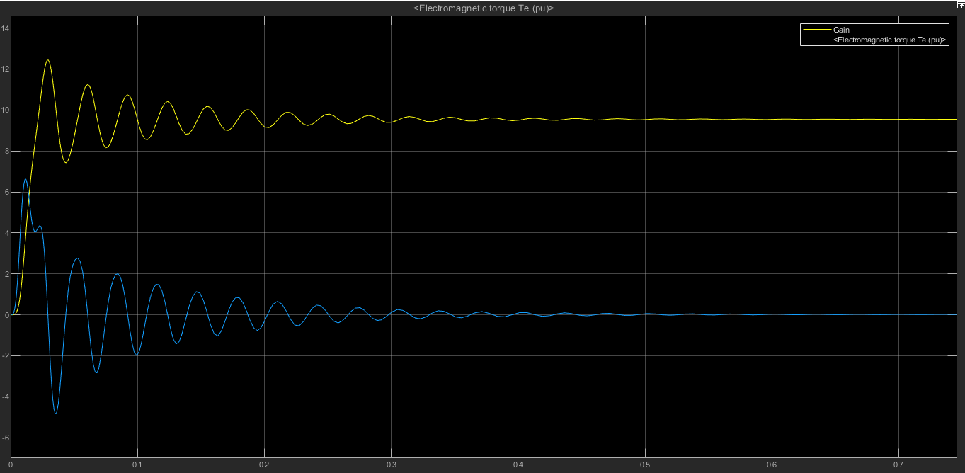
TORQUE AND SPEED

Slide 10
POWER FACTOR
The power factor of induction motors varies with load, typically from around 0.85 or 0.90 at full load to as low as about 0.20 at no-load.
At no load, an induction motor draws a large magnetizing current and a small active component to meet the no-load losses.
Therefore, the induction motor takes a high no-load current lagging the applied voltage by a large angle. Hence the power factor of an induction motor on no load in low.

Slide 11
INDUCTION MOTOR EFFICIENCY
Efficiency is the power out divided by the power in. Obviously, if there is no load on the motor, the power out and the efficiency are zero.
At no-load, the machine draws power from the system because there are still losses in the machine When a load is placed on the shaft of the motor, more power is drawn from the system and the efficiency must go up because the power out is now greater than zero. The efficiency will continue to increase as long as the output power increases faster than the input power.

Slide 12
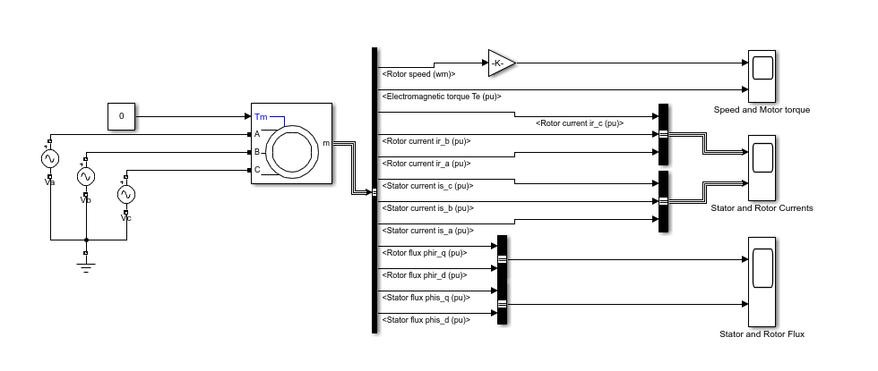
CIRCUIT

Slide 13
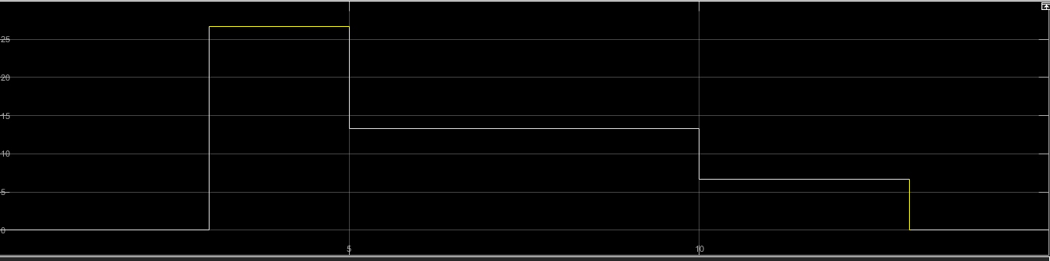
LODING CONDITIONS (CURVES)
LOADING TORQUE:

Slide 14
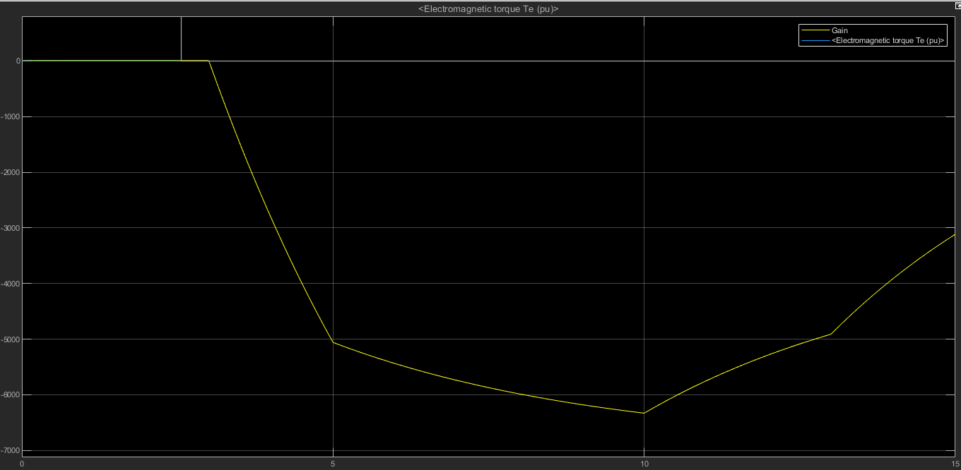
LODING CONDITIONS (CURVES)
OUTPUT SPEED AND TORQUE:

Slide 15
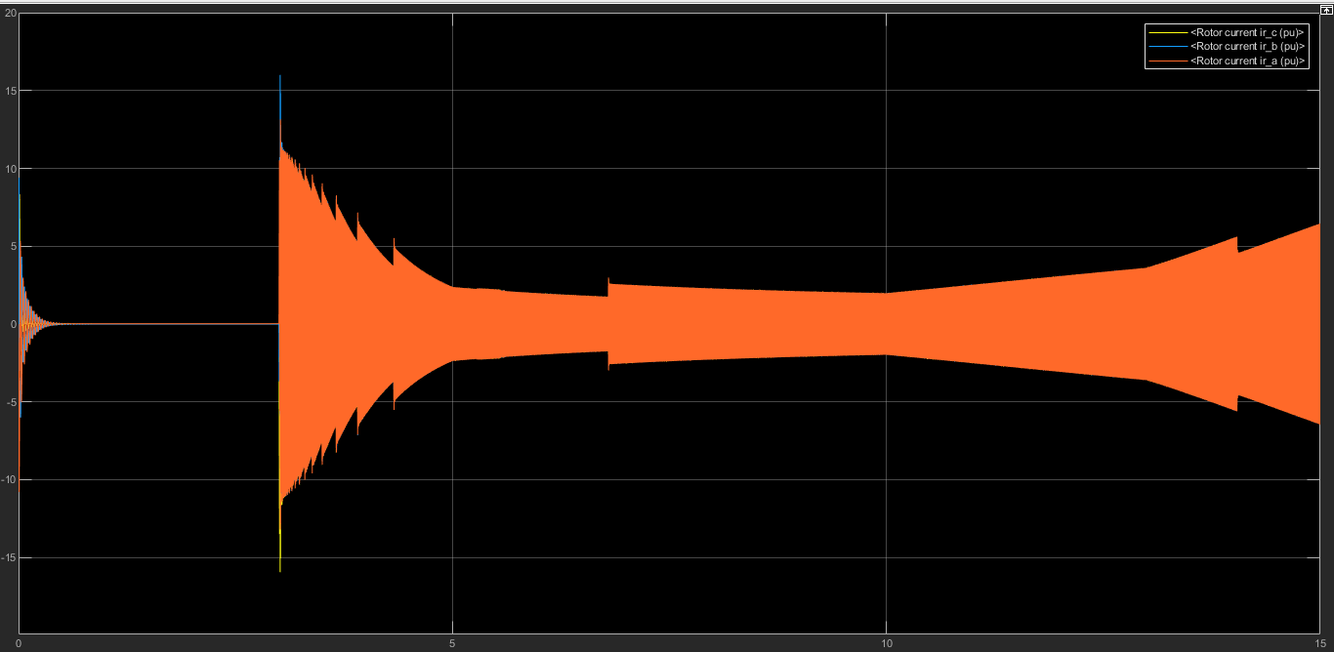
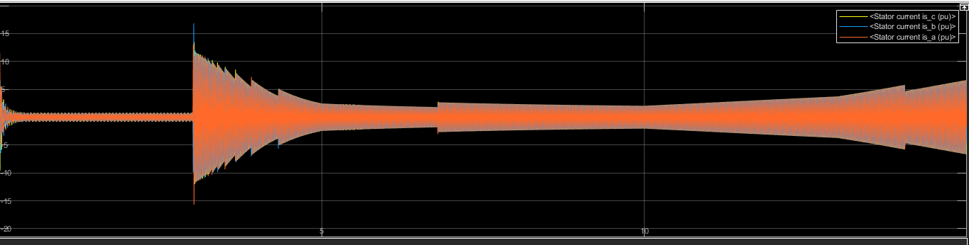
LODING CONDITIONS (CURVES)
ROTOR AND STATOR CURRENTS:

Slide 16
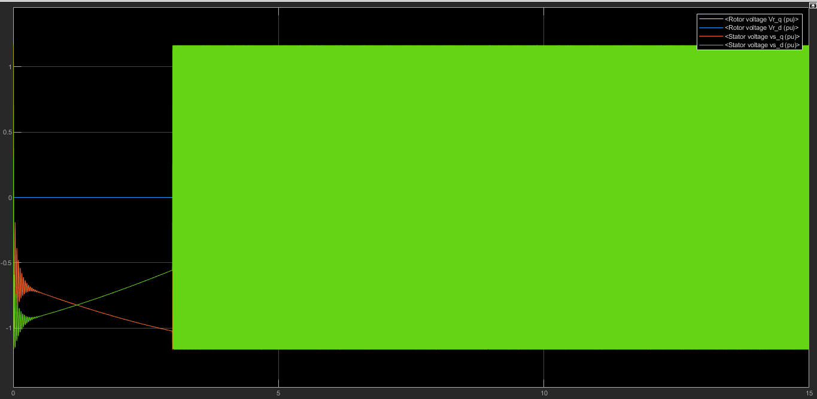
LODING CONDITIONS (CURVES)
TERMINAL VOLTAGES:

